Slide 1

CSCI 4502/5502
Data Mining - Fall 2023 - Lecture 13
Ravi Starzl, PhD

Slide 2
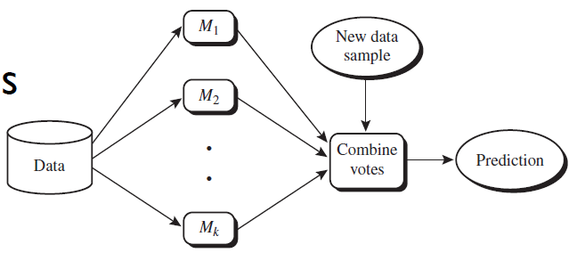
Ensemble Methods
Use a combination of multiple models to increase
accuracy
Popular ensemble methods
bagging: equal-weight votes
boosting: weighted votes
Ravi Starzl, PhD - Data Mining Fall 2023
Notes:
Ensemble methods merge multiple weaker predictors to create a stronger learning algorithm, enhancing prediction accuracy by drawing insights collectively from various models, thereby reducing bias and variance.
Bagging, also known as bootstrap aggregating, functions by merging predictions from several models, each trained on a unique subset of the data. All models in bagging contribute equally to the final decision, which is determined through majority voting. This method leverages diverse viewpoints to enhance prediction accuracy. For instance, when multiple models provide their independent predictions, the final decision is based on the most common choice among them.
On the other hand, Boosting works by building models in sequence, where each new model addresses the errors made by its predecessor. This is achieved by adjusting the importance of instances based on prior misclassifications. In boosting, models aren't treated equally; their influence on the final decision is based on their accuracy, granting more effective models a larger influence on the outcome.
Bagging and Boosting, though both rooted in ensemble techniques, differ in their methodologies, error correction mechanisms, and the influence each model exercises on the final decision. While bagging involves models operating concurrently and each having an equal influence on the outcome, boosting follows a step-by-step procedure where subsequent models learn from the preceding ones, with their influence on the final decision being based on their accuracy.
In conclusion, both Bagging and Boosting originate from the ensemble framework but employ different strategies. Each method offers specific benefits depending on the nature of the problem at hand. Their respective mechanisms, with Bagging's uniform contribution from all models and Boosting's error-centered approach with varied model influence, cater to diverse needs in machine learning's predictive modeling domain.

Slide 3

Bagging: Bootstrap Aggregation
Analogy: diagnosis by multiple doctors
multiple doctors’ majority vote
Training: given a data set D of d tuples
training set Di: d tuples sampled randomly with replacement (i.e., bootstrap)
classifier Mi is learned for Di
Classification: majority vote
Prediction: average of multiple predictions
Ravi Starzl, PhD - Data Mining Fall 2023
Notes:
Bagging, which stands for Bootstrap Aggregation, is a prominent ensemble technique designed to counterbalance issues such as overfitting and elevated variance, commonly associated with decision trees.
To conceptualize the idea, consider the process of seeking medical advice. One could rely on a singular opinion from a doctor or solicit multiple opinions to reach a consensus. The ensemble approach, akin to seeking multiple medical opinions, diminishes the likelihood of erroneous conclusions by tempering the variability and producing a more consistent outcome. This philosophy underpins Bagging in the realm of machine learning.
Given an originating dataset, denoted as D, encompassing 'd' tuples, Bagging establishes a new training set, termed D_i, also comprising 'd' tuples. These tuples are chosen at random from D with the possibility of repetition, which implies that some instances might be duplicated in D_i, while others might be omitted entirely.
This procedure is iteratively executed to generate numerous D_i datasets derived from the primary D. Each D_i is then employed to train a distinct classifier, designated as M_i. For instance, if D contains 100 tuples and 50 D_i datasets are constituted, each with 100 tuples arbitrarily sourced from D, this would culminate in 50 distinct classifiers, ranging from M_1 to M_50.
For the purpose of classification or prediction, every M_i evaluates the test data, rendering a classification or forecast. Subsequently, a consensus mechanism, akin to a "vote", is instituted among all M_i outputs. In classification scenarios, the prevalent verdict across all M_i classifiers is typically embraced, curbing the potential for misclassifications by necessitating a collective error across a majority of M_i classifiers.
The quintessential advantage of Bagging resides in its capacity to diminish variance. By synthesizing supplementary data from the initial dataset, Bagging curtails the variability in predictions. In scenarios involving regression, the ultimate prediction typically embodies the average of all M_i outputs, ensuring an equanimous consideration of each prediction.
In essence, Bagging serves as a formidable ensemble technique, amplifying the efficacy and precision of singular models. An extension of Bagging, known as Random Forests, integrates added stochastic elements both in the formation of each D_i and in the election of feature subsets during decision tree bifurcations. Through the generation of diverse models and the amalgamation of their outputs, Bagging efficaciously counters overfitting. It is especially adept for datasets with pronounced variance. Although it doesn't entirely obviate underfitting, it markedly curtails the variance in predictive models, transmuting an average model into a dependable, high-caliber one. This furnishes a resilient and precise prediction apparatus, laying the groundwork for further exploration into ensemble techniques and their multifaceted applications.

Slide 4

Boosting
Analogy: diagnosis by multiple doctors
weighted by previous diagnosis accuracy
Weights are assigned to each training tuple
A series of k classifiers is iteratively learned
After classifier Mi is learned, adjust weights so Mi+1 pays more attention to tuples that were misclassified by Mi
M* combines the votes of all k classifiers, weighted by individual accuracy
Ravi Starzl, PhD - Data Mining Fall 2023
Notes:
Boosting is a machine learning technique that can be likened to a team of doctors collaboratively diagnosing a patient. Each doctor, or classifier in the context of boosting, adds to the final decision, with a trust score reflecting their past accuracy, similar to weights in boosting.
In boosting, classifiers are given weights based on their past performance. These weights indicate the relevance of each classifier's contribution to the final decision. The method functions iteratively, adjusting both classifier and training data weights dynamically. If a classifier struggles with certain data points, its weights are modified, prompting the subsequent classifier to focus more on those challenging points, aiming to correct prior misclassifications.
Classifiers in boosting are trained one after the other, with every new classifier targeting the mistakes of its predecessor by emphasizing misclassified data. After training, either upon reaching a predefined iteration count or a target accuracy, the model compiles results from all classifiers. The final outcome is the result of combining the weighted decisions of all classifiers, choosing the decision with the most weight as the ultimate output.
Boosting is a prime example of ensemble learning, where multiple models collaborate to boost overall accuracy. By adjusting weights and allowing each classifier to address the errors of the one before it, the model's accuracy is progressively enhanced. Thus, through the collective wisdom of multiple, potentially weaker classifiers working together, boosting forms a powerful and precise prediction model.

Slide 5

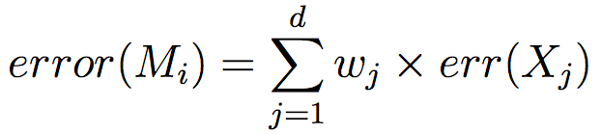
Adaboost (1)
D: (X1, y1), (X2, y2), ..., (Xd, yd)
Initial weight of each tuple: 1/d
Round i (i=1, ..., k)
Di: sample d tuples w/ replacement from D
Pr(choose tuplej) based on tuplej’s weight
Learn Mi from Di, compute its error rate
Ravi Starzl, PhD - Data Mining Fall 2023
Notes:
Adaboost begins by assigning equal importance to each tuple in the training set, illustrating an initial state where every tuple has an equal chance of being chosen.
The algorithm functions in cycles, creating unique datasets in each iteration and bestowing them with specific sample weights. A correctly classified tuple sees its weight reduced, whereas an incorrectly classified tuple has its weight increased. This adjustment dictates the probability of a tuple being chosen in the following iterations, ensuring that previously misclassified tuples receive heightened focus in ensuing models.
Within the Adaboost framework, simple models or classifiers, often termed decision stumps, are pivotal. While these models might not be highly precise, they are expected to outperform mere random predictions. The iterative procedure concludes when either all tuples are perfectly classified or after a predefined number of iterations.
Each model's performance is gauged through its error rate. Models demonstrating an error rate exceeding 0.5 are discarded. A model's influence in the final prediction is determined by its error rate, with lower error rates leading to more significant influence.
At the algorithm's culmination, every classifier predicts outcomes for unobserved instances, with the definitive decision relying on a weighted consensus. Classifiers with superior performance during training command greater influence over this final decision.
To provide a tangible illustration, envision predicting a patient's ailment based on multiple lab tests. Each test, acting as a rudimentary classifier, may excel at detecting certain ailments but falter with others. Adaboost facilitates the amalgamation of these classifiers into a more robust predictor, adjusting the significance of each test based on its diagnostic prowess. Through numerous iterations, each rudimentary classifier is ascribed a weight contingent on its accuracy, and the more diagnostic tests have an amplified impact on the final verdict.
In essence, Adaboost commences with uniform weights for every data instance, progressing through cycles of data sample selection, rudimentary model training, performance evaluation, and weight adjustment. The ultimate prediction emerges from a weighted consensus.

Slide 6
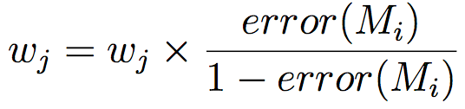
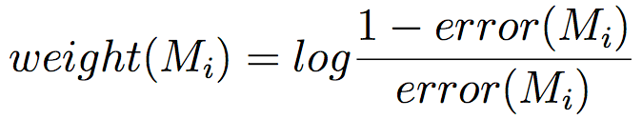
Adaboost (2)
Round i (continued)
Reduce weights of correctly classified tuples
Normalize tuple weights so sum is 1.0
e.g., (0.1, 0.3, 0.1) => (0.2, 0.6, 0.2)
Classification: weighted votes of k classifiers
Ravi Starzl, PhD - Data Mining Fall 2023
Notes:
The algorithm initiates by equally weighting all instances in the training set. Given a dataset of 100 emails, each email is initially assigned the same weight of 0.01. The first weak classifier, perhaps a simple rule like classifying an email as spam if it contains the word 'free', is applied. Following this application, the performance of the classifier is evaluated and weights of incorrectly classified instances are increased.
Weights are then normalized to ensure their total sums to one, a crucial step that constrains the learning progression of the model and ensures the algorithm maintains its integrity through various adjustment rounds. Simultaneously, a 'classifier weight' is computed based on the classifier’s error rate, assigning a larger weight to classifiers with a lower error rate, thereby directly introducing a merit-based system among classifiers and enhancing the accuracy and reliability of the AdaBoost algorithm.
The aforementioned process is iterated through multiple rounds, with each round introducing a new weak classifier that prioritizes instances misclassified in preceding rounds. Iteratively, the errors of each classifier inform the next classifier, reducing cumulative errors as the process unfolds.
In the decisive stage, all weak classifiers converge. Each classifier casts a vote to classify a new instance based on its rules, with each vote being weighted. The higher the weight, the greater the influence on the final decision. This weighted voting system facilitates an adaptive response to the complexity of data instances and leverages the distinct capabilities of each classifier. Consequently, the final output melds the insights of numerous classifiers, culminating in an intelligent, boosted prediction model that surpasses any single classifier.

Slide 7

Ensemble Methods: Accuracy
Bagging
often significantly better than single classifier
noise: not considerably worse, more robust
prediction: proved improved accuracy
Boosting
generally better than bagging
may overfit the model to misclassified data
Ravi Starzl, PhD - Data Mining Fall 2023
Notes:
Ensemble methods amalgamate multiple machine learning techniques to formulate a model that enhances predictive accuracy beyond what is achievable by individual models. The purpose of ensemble methods is to consolidate predictions from multiple models, thereby reducing errors and improving overall model performance.
Bagging, or Bootstrap Aggregating, involves training multiple models in parallel, each on a unique subset of the data, which is derived via bootstrap sampling. The final prediction is an amalgamation of the predictions from each model, typically achieved through majority voting in classification problems and averaging in regression. The parallel training and aggregation of predictions from multiple models in Bagging assist in reducing variance, mitigating overfitting, and providing a robust model especially in the presence of noise and outliers.
In contrast, Boosting employs a sequential training process, where each subsequent model is trained to correct the errors of its predecessors. The models, once trained, combine their outputs through a weighted sum to produce the final prediction. Boosting focuses on sequentially improving predictions, particularly for instances that are challenging to predict. Although it often provides superior model accuracy compared to Bagging, Boosting can be prone to overfitting, especially when it attempts to correct too ardently for misclassifications or noise in the data.
Comparing Bagging and Boosting, Bagging primarily reduces variance while maintaining bias, offering a model that is robust to noise. Boosting, on the other hand, primarily targets the reduction of bias, potentially at the expense of introducing some variance, and presents a model that, while often more accurate, may be prone to overfitting. The selection between Bagging and Boosting hinges on the specific problem context and characteristics of the data.

Slide 8
1
Bayesian belief
networks
2
Backpropagation
Advanced Classification
3
Support vector
machines
4
Lazy learning
5
Additional topics
regarding classification
6
Summary
Ravi Starzl, PhD - Data Mining Fall 2023

Slide 9

Naïve Bayesian Classifier
Advantage
easy to compute, good results in most cases
Disadvantage
assumption: class conditional independence
dependencies exist in practice: e.g., hospital patients: age, family history, fever, cough, lung cancer, diabetes, etc.
Ravi Starzl, PhD - Data Mining Fall 2023
Notes:
Naïve Bayesian Classifier operates under Bayes’ theorem, providing a means to compute the probability of an event based on prior related knowledge. Its application spans various domains such as spam filtering, sentiment analysis, and medical diagnostics, attributed to its ability to classify data based on known probabilities.
The 'Naïve' aspect of the classifier assumes independence among predictors, implying that the presence of a feature does not influence the presence of any other feature. For instance, in email spam filtering, each word in an email is considered an independent feature, and the classifier determines whether the email is spam or not by ignoring dependencies between words. Despite this simplification, the classifier maintains reasonable accuracy and computational efficiency.
This classifier is especially effective in scenarios requiring rapid computation and the handling of large feature spaces due to its computational efficiency and ability to provide useful results across various applications. However, its foundational principle, the assumption of independent predictors, also presents a limitation. In real-world scenarios, predictors are often interrelated, and disregarding these correlations may lead the classifier to oversimplify data, potentially affecting accuracy.
In certain situations, the classifier maintains efficiency despite its limitations, particularly when correlations among predictors are uniformly distributed, allowing it to circumvent the independence assumption without significantly affecting performance.
Selecting a model, such as the Naïve Bayesian Classifier, necessitates considering the context and data nature, ensuring optimal results in machine learning applications, especially in multi-dimensional data classification. Understanding the classifier’s operations allows for leveraging its capabilities while remaining mindful of its limitations and applicable scenarios.

Slide 10
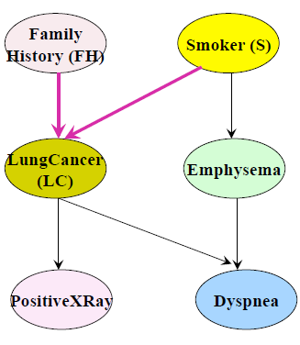
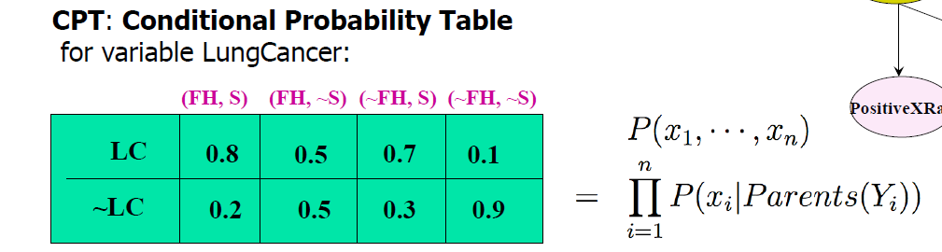
Bayesian Belief Networks
Subset of variables conditionally independent
Causal model: a directed, acyclic graph
node, link, parent, CPTs
Ravi Starzl, PhD - Data Mining Fall 2023
Notes:
Bayesian Belief Networks, or Bayesian Networks, serve as pivotal entities within probabilistic graphical modeling. They exhibit a dual-functionality: visually and mathematically representing relationships between disparate variables, primarily focusing on random variables and conditional dependency.
Conditional independence is a cardinal principle within Bayesian Networks, implying that subsets of variables within the network maintain a conditional independence from others, contingent on specific conditioning events. For instance, given three variables, X, Y, and Z, where X depends on Y and Y depends on Z, once Y is known, X and Z maintain conditional independence. This principle significantly mitigates computational complexity and information requirements for accurate evaluation and inference.
Structurally, Bayesian Belief Networks manifest as Directed Acyclic Graphs (DAGs), comprising nodes representing unique entities or variables, and directed links indicating causality. These directed relationships assign a 'parent' status to the originating node or event and avoid cyclic occurrences, preventing circular causal relationships.
To illustrate, consider a medical Bayesian Network comprising nodes such as Family History (FH), Smoker (S), and Lung Cancer (LC), interlinked with diverse dependencies and probabilities.
To numerically express the conditional probabilities of various variable states, Conditional Probability Tables (CPTs) are employed. These tables provide probabilities for variable outcomes, considering various parent variable states. For instance, a CPT for the 'Lung Cancer' variable, given two states (LC and ~LC, where ~ denotes negation), must include the probabilities for each possible state combination of its parent variables, Family History and Smoker.

Slide 11
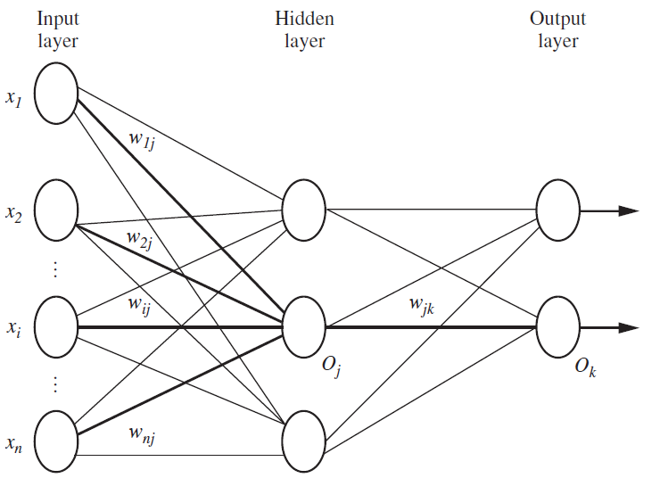
Neural Network
Connected input/out units
Weighted connections
Multi-layer
Feed-forward
Fully connected
Backpropagation
Adjust weights
Ravi Starzl, PhD - Data Mining Fall 2023
Notes:
Neural networks stand as a beacon in the realm of artificial intelligence and machine learning, symbolizing our attempts to emulate the intricate workings of the human brain through computational models. These networks, composed of algorithms that work cohesively, learn and make decisions by processing observational data.
A neural network is built upon layers, each designated a specific role in the processing and transmission of data. The foundational layers - the input, hidden, and output layers - form a structural pipeline through which data moves and is refined at each stage. Data enters the network via the input layer, is processed and refined through one or more hidden layers, and exits with a final output, transformed and informed by the network's learned patterns and weights.
Every node, or 'neuron', in these layers is connected, creating a dense network that enables the seamless transmission and transformation of data from input to output. These connections, or 'weights', dictate the influence one neuron has over the next, with higher weights indicating a stronger influence. The learning and adaptation of a network are largely driven by the adjustment of these weights, optimized to reduce error and enhance predictive accuracy.
Multi-layer neural networks, with numerous hidden layers, harness their computational power to address complex problems, establishing themselves as crucial tools in various domains, from data mining to pattern recognition. These multiple layers afford the network an enhanced ability to learn from data, enabling the extraction and utilization of more abstract and complex features from the input data.
Crucial to the learning process are the mechanisms of 'feed-forward' data propagation and 'backpropagation' of error. In the feed-forward phase, data moves in a unidirectional flow from input to output, traversing through the hidden layers and being transformed at each stage. Backpropagation, on the other hand, involves the retroactive adjustment of weights, minimizing the error from previous predictions and enhancing the accuracy of subsequent ones.
A visual representation of a neural network provides a tangible manifestation of these interconnected layers, nodes, and weights, allowing learners to visualize and better comprehend the structural and functional intricacies of the network. Such visualizations are pivotal for learners and practitioners to conceptually map and understand the foundational and advanced workings of neural networks.

Slide 12
Network Topology
# hidden layers, # units in each layer
Input values
continuous: normalize to [0.0, 1.0]
discrete: one unit per attribute value, initially 0
Output: 1 unit per class if more than two classes
Trial-and-error: different topology, different initial weights
Ravi Starzl, PhD - Data Mining Fall 2023
Notes:
The input layer emerges as the initial point of contact between the network and raw data, acting as the receptacle for real-world data and initiating the preliminary data pre-processing. Each node in this layer represents a unique characteristic or feature, becoming a crucial parameter that defines each instance within the dataset.
As we delve into data types and their preparation, we observe that continuous or real-valued data is typically normalized, conforming it to a uniform range from 0.0 to 1.0. This ensures a consistent platform for the network to process variables that exist on varied scales. In parallel, categorical or discrete values are converted into a binary form, providing a complementary method to process these distinctly different data types.
Transitioning into the hidden layers, the network undertakes the bulk of its computational processing. These layers, although hidden from direct interface with external data, perform pivotal operations, identifying and mapping non-linear relationships within the data. The complexity of a network is often mirrored in the number of hidden layers it possesses, with each layer and unit intricately entwined in a mathematical dance that explores and defines the relationships within the data.
Arriving at the output layer, the network concludes its journey, classifying and predicting outcomes based on the processed inputs. The number of nodes within this layer is intricately tied to the nature of the problem at hand, whether it be binary or multiclass classification, guiding the network in producing relevant and accurate predictions.
The concept of weights forms the backbone of the inter-node connections, influencing the transmission of information within the network. These weights, which are adjusted during the training phase, play a pivotal role in defining the influence one node exerts over another, thereby shaping the learning and predictive capabilities of the network.
Configuring and optimizing a network is an art, one that requires a delicate balance between achieving high accuracy and maintaining computational efficiency. The process, inherently iterative and experimental, navigates through potential pitfalls such as overfitting and underfitting, striving to carve out a network that is both accurate and efficient.
To enhance predictive precision, robust resampling methods like k-fold cross-validation are often employed. This method, which divides the dataset into ‘k’ subsets or folds, provides a more resilient estimate of the model’s performance, offering a practical approach to improving predictability amidst the complexities of network design and implementation.

Slide 13
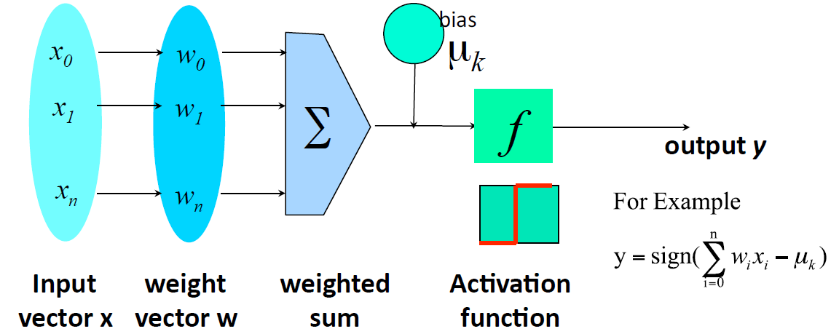
Neuron
A hidden/output layer unit
Ravi Starzl, PhD - Data Mining Fall 2023
Notes:
Artificial neurons or nodes are fundamental components in neural networks, taking multiple inputs and producing a single output. Each input is associated with a weight, which signifies its influence and is adjusted during the training phase to improve the predictive capacity of the model.
A weight vector in an artificial neuron is structured as a column vector and contains multiple weights, each corresponding to a specific input. Weights are linked to their respective inputs and combined to form the weight vector. Although the concept is clear, graphical representation or practical examples can further simplify understanding.
The bias unit is denoted as \(w_0\) or \(b\) and functions to shift the output produced by the activation function. The bias unit maintains a consistent value of 1 and, like weights, is adjusted during the model's training phase.
Activation functions introduce non-linearity into neural networks, enabling them to predict complex data patterns. Different activation functions such as Sigmoid, Tanh, ReLU, Leaky ReLU, and Softmax are commonly used in neural networks, each having its specific application. A brief description or comparison of these functions can provide better insights into their respective use-cases.
The output from the activation function, 'y', can be either the final outcome, if it originates from an output layer node, or used as an input for nodes in subsequent layers, if it comes from a hidden layer node.
Artificial neurons, despite their simplicity, can perceive and model complex non-linear scenarios when integrated into a network of hidden and output layer units. This complexity enables the learning of nuanced patterns and facilitates deep learning. The fundamental operation of artificial neurons, involving a set of weights, bias, and an activation function, remains constant regardless of the complexity of the constructs.

Slide 14
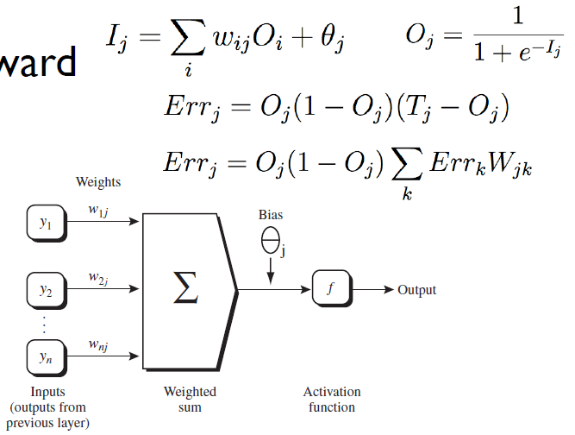
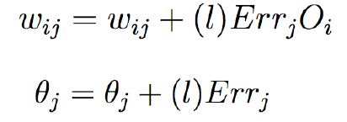
Backpropagation
Initialize weights, biases: small random numbers
Propagate the inputs forward
Backpropagate the error
Terminating condition
Ravi Starzl, PhD - Data Mining Fall 2023
Notes:
An artificial neuron or node, often used interchangeably, is a fundamental element in the realm of neural networks, which are widely utilized in machine learning and artificial intelligence. An artificial neuron takes a set of inputs, and each input is assigned a specific weight. These weights represent the influence of the corresponding inputs. During the training phase of the model, the weights are subject to adjustments to fine-tune the predictive accuracy of the model in subsequent uses.
In the context of neural networks, a weight vector is assembled as a column vector and contains various weights, each corresponding to an individual input variable. The weight vector, therefore, holds the numerous weights, each linked to its respective input.
A bias unit, typically noted as w, 0, or b, is instrumental in shifting the output of the activation function. This unit, notable for its consistent value of 1, serves as a unique weighted input and, like weights, undergoes adjustment during the training phase of a model.
The activation function, denoted as µ, k, or 'f', plays a pivotal role in the artificial neuron by transforming the weighted sum of its inputs and the bias. The activation function introduces non-linearity into the neural networks, enabling them to learn and predict complex data patterns. There are several types of activation functions, such as Sigmoid, Tanh, and ReLU, each with its characteristics and use-cases.
In the output of an artificial neuron, 'y', which is the result from the activation function, is interpreted as the output of the neuron. This output could indicate the final outcome if it comes from an output layer node, or act as an input for nodes in subsequent layers if it originates from a hidden layer node.
Every neuron within a neural network functions as a mathematical entity, computing a weighted sum of its inputs, adding the bias, and determining its activation state via the activation function. The core principle of how a neural network accumulates knowledge resides in the iterative refinement of its weights and bias units, informed by the output from the activation function.
Artificial neurons, despite their seemingly straightforward design, showcase a remarkable potential to perceive and model complex non-linear scenarios when integrated into a network of hidden and output layer units. While augmented complexity facilitates the learning of nuanced patterns and progression toward deep learning, their fundamental principle remains consistent: a singular neuron operates on its unique set of weights, bias, and activation function.

Slide 15

Neural Network as Classifier
Weakness
long training time; parameters determined empirically; poor interpretability
Strength
high tolerance to noisy data; can classify untrained patterns; well-suited for continuous-valued inputs & outputs; success on a wide array of real-world data; inherently parallel; rule extraction
Ravi Starzl, PhD - Data Mining Fall 2023
Notes:
Neural Networks, pivotal in machine learning, embody a spectrum of strengths and weaknesses intrinsic to their design and functionality.
Focusing on weaknesses, one encounters the challenge of extensive training time, notably observed in the back-propagation process, which meticulously adjusts neuron connection weights through numerous iterations of forward and backward passes. This duration amplifies with the progression to deep learning networks, where multiple layers of neurons exist, especially when managing large datasets or intricate tasks, thereby intensifying the computational resources and time required.
Another issue surfaces with the empirical determination of parameters, such as the architecture of the network, number of layers and neurons, and the learning rate. Determining these hyperparameters, often through a trial and error approach, is resource-demanding and inefficacious in efficiently deriving an optimal network architecture for a specific task.
The interpretability of Neural Networks also poses a hurdle, where the 'black-box' problem emerges due to the elaborate and intertwined structure of networks. Discerning the influence of individual weights on final decisions becomes a non-trivial task, resulting in challenges in sectors necessitating transparency like medical diagnostics or finance.
Turning to strengths, Neural Networks exhibit a commendable tolerance towards noisy data, enabling them to manage unwanted alterations in data by learning patterns and effectively disregarding such noise, thereby enhancing their predictive capabilities. This attribute is valuable in handling real-world data, where purity cannot always be ensured.
Neural Networks can classify patterns they have not been trained on. This attribute, known as 'generalization', allows them to classify unseen instances by comparing them with trained patterns, thereby serving as a vital characteristic in machine learning models.
Neural Networks also adeptly manage continuous-valued inputs and outputs, processing continuous data directly without necessitating discretization, making them suitable for tasks like regression or predictions involving continuous data.
Neural Networks have successfully permeated various industry practices such as AI, image and speech recognition, and customer intelligence, among others, proving their utility across diverse applications.
An additional strength is the parallelizability of Neural Networks. Given the independent functionality of each neuron, computations can be simultaneously executed across different processors, enhancing computational efficiency and reducing overall pre-processing time, which is crucial for large-scale applications.

Slide 16
1
Bayesian belief
networks
2
Backpropagation
Advanced Classification
3
Support vector
machines
4
Lazy learning
5
Additional topics
regarding classification
6
Summary
Ravi Starzl, PhD - Data Mining Fall 2023
Notes:
Support Vector Machines (SVMs) originated in the 1990s, developed by Corinna Cortes and Vladimir Vapnik, and have since established themselves as potent tools for binary classification problems. These problems involve categorizing objects into one of two classes based on their features, finding applications in various domains, including fraud detection in banking and disease diagnosis in healthcare.
SVMs function as a type of supervised learning model, utilizing a dataset comprising features (inputs or predictors) and outcomes (labels). The model learns the relationship between the features and labels, subsequently enabling it to predict the label of unseen data points. Specifically, SVMs determine a hyperplane in a high-dimensional space that separates two classes with the widest possible margin, aiming to maximize this margin to establish a decision boundary that maintains the greatest possible distance from both classes. SVMs permit a degree of misclassification, offering robustness against overfitting.
The complexity of finding the separating hyperplane is mitigated through the dual problem, transforming the original optimization problem into a more manageable form. Only data points labeled as 'support vectors' impact the solution of the problem in this dual form.
In practical applications, after training the SVM using labeled training data, it predicts the labels of unseen data. An example use case is text classification, such as categorizing emails as spam or not spam, wherein emails are represented using selected features, and the SVM is trained on a set of emails labeled as spam or not spam before classifying new emails.
SVMs can process both linearly and non-linearly separable datasets. Kernel functions enable SVMs to address non-linear problems by transforming the original feature space into a higher-dimensional one where the data becomes linearly separable. Linear kernels, equivalent to the dot product of the feature vectors, are suitable for data with a few features, while polynomial and Gaussian Radial Basis Function (RBF) kernels are common choices for complex data.
However, SVMs also present limitations. Being binary classifiers, they necessitate transforming multiclass problems into multiple binary problems, which can be computationally demanding and complicate the process. Additionally, SVMs do not directly provide probability estimates for predictions, which can be computed but require additional pre-processing. Also, avoiding overfitting becomes challenging in SVMs when the number of features substantially outweighs the number of observations.

Slide 17
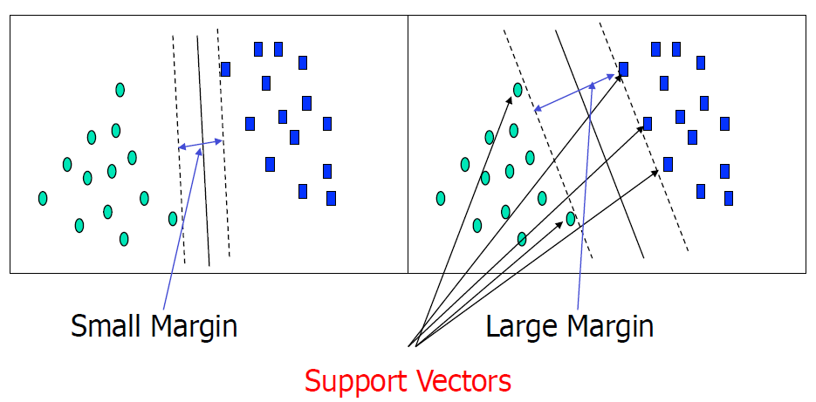
SVM Example
Linearly separable data
Ravi Starzl, PhD - Data Mining Fall 2023
Notes:
Support Vector Machines (SVM) are instrumental in machine learning, especially for tasks involving high-dimensional or limited datasets. SVMs differentiate between distinct classes within a dataset by establishing an optimal hyperplane that separates the classes.
Linearly separable data is a concept in which a dataset can be perfectly divided by a line (in two dimensions), a plane (in three dimensions), or a hyperplane (in more than three dimensions) such that datapoints from different classes are on different sides of the line, plane, or hyperplane. Real-world data often defies such straightforward separation. The 'kernel trick' used by SVM projects complex, non-linearly separable data into a higher-dimensional space where a hyperplane can separate it, thus allowing for effective classification.
Support vectors are critical datapoints in SVMs, located closest to the decision boundary, or the separating hyperplane. The elimination of these vectors would alter the position of the decision boundary. While all datapoints contribute to the SVM model, the support vectors have a substantial impact due to their proximity to the decision boundary and their role in defining the classifier's margin.
Margin in SVM refers to the space between different classes of data divided by the decision boundary. A small margin implies the hyperplane is close to datapoints from different classes, potentially leading to overfitting, while a large margin classifier seeks the widest possible separation between classes. SVM aims to construct a maximum-margin hyperplane that balances class separation and margin adequacy, enhancing its predictive capability and generalization to new, unseen data.

Slide 18
SVM: Linearly Separable Data
D: (X1, y1), ..., (X|D|, y|D|),
Xi is n-dimensional
A separating hyperplane
W * X + b = 0
Find maximum marginal hyperplane (MMH)
Hyperplanes H1 and H2
sides of the margin
Support vectors
training tuples fall on H1 H2
Ravi Starzl, PhD - Data Mining Fall 2023
Notes:
A comprehensive explanation of Support Vector Machines (SVM) and the concept of linearly separable data is presented, including key terminologies like weightage, bias, and input vector. However, the inclusion of graphical illustrations and practical examples to visualize the concepts of SVM and Maximum Marginal Hyperplane (MMH) would enhance understanding.
Limitations of SVM: While the requirement for data to be linearly separable in SVM is noted, the discussion does not explore the implications or solutions when data is not linearly separable, such as utilizing the kernel trick. The information is informative but lacks comprehensiveness.
Learning Outcomes and Applications of SVM: The learning outcomes and practical implications of SVM are well-defined, highlighting its potential with high-dimensional, low-sample size data. The inclusion of more practical applications and comparisons with other algorithms would provide a more practical and broad perspective on SVM's utility.
Kernel Trick and Beyond Linear Classifications: The kernel trick is adeptly explained as a method that allows SVM to handle non-linearly separable data by projecting it into a higher-dimensional space. Various kernel functions are introduced, illustrating the flexibility and computational efficiency of the approach.
Practical Applications and Comparisons of SVM: SVM’s various applications in different fields, such as image classification and bioinformatics, are acknowledged, alongside its balancing act between classification accuracy and model complexity. The discussion would benefit from a more detailed comparative analysis with other algorithms and an exploration of real-world application nuances.

Slide 19
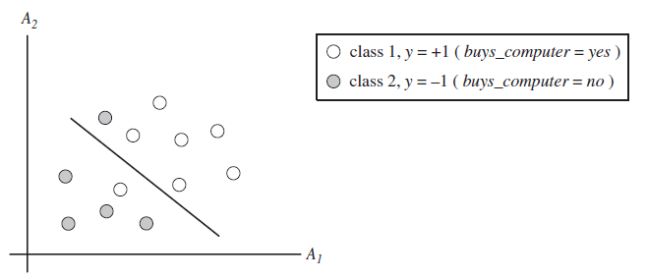
SVM: Linearly Inseparable
Transform data into a higher dimension
Search for optimal linear separating hyperplane in the new space
Computing dot product on the transformed data mathematically
equivalent to applying a kernel function to original data
K(Xi, Xj) = ∅(Xi)⋅∅(Xj)
Ravi Starzl, PhD - Data Mining Fall 2023
Notes:
The concept of 'linear separability' and its associated challenges are effectively explored through practical scenarios. The solutions for dealing with non-linearly separable data are explained, providing a resolution for the identified obstacle.
The mechanism of transforming data into higher-dimensional space to navigate linear inseparability is well-articulated, giving readers insight into how SVM resolves the intricacies of real-world data.
The concept of the hyperplane and its optimization in SVMs is expertly explained. The material thoroughly explores how SVMs function, the pivotal role of support vectors, and the maximization of the margin, offering readers a nuanced understanding.
The material adeptly details SVM’s computation of dot products and the vital role of kernel functions in reducing computational burden. The inclusion of the mathematical model of a popular kernel function enhances the technical depth.
The concluding section effectively encapsulates the key concepts discussed, offering a coherent summary of SVM operations, the advantages of kernel functions, and the robustness of SVM as a machine learning model.
Linear separability, a scenario where data classes can be distinctly separated by a hyperplane, often presents a challenge in real-world data, which may intertwine and overlap. SVM resolves this by employing the kernel trick, transforming input data into higher-dimensional space, rendering non-linearly separable data in original space as separable in the higher-dimensional space.
Upon transformation to a higher dimension, SVM determines a hyperplane that segregates the points for classification. The optimal hyperplane maximizes the distance between itself and the nearest points (support vectors) from each class it separates, allowing a certain degree of error and enhancing SVM’s robustness.
Kernel functions in SVM facilitate the computation of dot products of vectors in a higher-dimensional space without significantly increasing computational complexity. Varied types of kernel functions, such as linear, polynomial, and radial basis function (RBF), are utilized in SVM, tailoring to the complexity of the data.

Slide 20
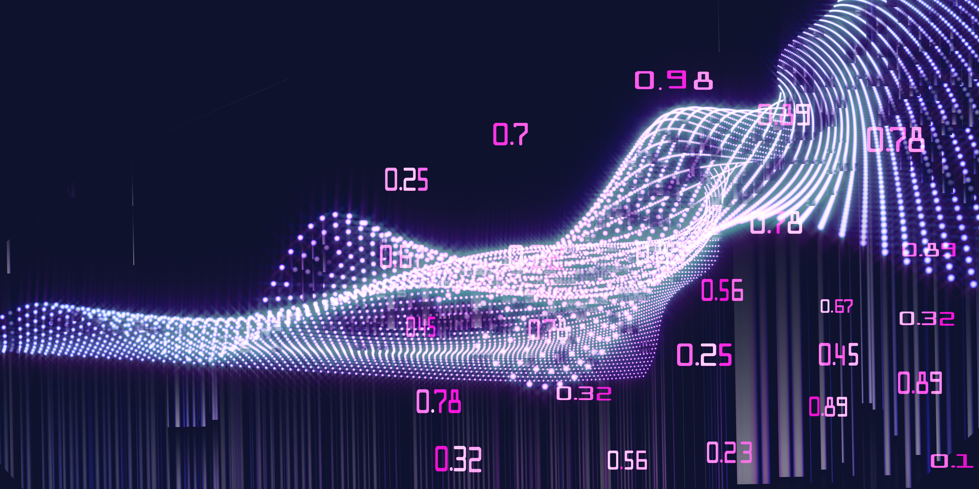
Support Vector Machines
Classification for both linear & nonlinear data
Transforms data to higher dimension using nonlinear mapping
Searches for optimal linear separation hyperplane in the new dimension
SVM finds this hyperplane using support vectors (“essential’’ training tuples) and margins (defined by the support vectors)
Ravi Starzl, PhD - Data Mining Fall 2023
Notes:
Support Vector Machines (SVM) perform classification tasks for linear and nonlinear data. In the context of nonlinear data, SVM applies a nonlinear mapping to transform the input data into a higher-dimensional space. The algorithm identifies an optimal hyperplane in this new space that linearly separates the data into distinct classes. The identification of the hyperplane is influenced by specific training tuples known as support vectors. Margins, which are determined by the support vectors, dictate the separation of data on either side of the hyperplane. The algorithm aims to maximize these margins to enhance the robustness and generalization of the model in classifying unseen data.

Slide 21
1
Bayesian belief
networks
2
Backpropagation
Advanced Classification
3
Support vector
machines
4
Lazy learning
5
Additional topics
regarding classification
6
Summary
Ravi Starzl, PhD - Data Mining Fall 2023

Slide 22

Lazy vs. Eager Learning
Eager learning: constructs classification model on training data before receiving test data
Lazy learning: stores training data and delays processing until a new instance must be classified
Lazy: less time in training, more time in predicting
Lazy: require efficient storage techniques
Lazy: richer hypothesis space using many local linear functions for implicit global approximation
Ravi Starzl, PhD - Data Mining Fall 2023
Notes:
Lazy learning, exemplified by the k-NN algorithm, only constructs its model during the prediction phase. With k-NN, each new instance to be classified prompts the model to identify the 'k' instances most similar to the new instance, denoted as 'neighbors.' Subsequently, the new instance is classified based on the predominant class among its neighbors. This strategy of extracting relevant training data instances 'on demand' quintessentially defines lazy learning.
Navigating through the practical implications of eager and lazy learning, computational costs, data management strategies, and impacts on model accuracy emerge as pivotal considerations. Eager learning, while resource-intensive during training, facilitates swift predictions, albeit with the challenge of avoiding overfitting by ensuring the model does not become excessively complex relative to the dataset size.
Lazy learning amplifies the prediction phase's duration, as the true computational work commences only when a new instance requires classification. Furthermore, lazy learning mandates efficient data storage techniques for seamless data retrieval during predictions, especially with voluminous datasets. Despite its dynamic and flexible prediction approach, lazy learning may introduce elevated prediction errors, given its tendency to produce a high-bias and low-variance model.
Eager and lazy learning epitomize a fundamental trade-off in machine learning, oscillating between resource allocation during the training phase and the prediction phase. While eager learning demands substantial resources during training to build a comprehensive model, enabling efficient predictions subsequently, lazy learning economizes on training phase resources, awaiting the prediction stage to formulate the model. This allows lazy learning to dynamically adjust to various local model forms, albeit at the cost of an increased prediction phase duration and necessitating optimized data storage methodologies.
The practical implications of choosing between eager and lazy learning hinge on the alignment of their respective strengths and weaknesses with the specific requisites of the problem at hand. For scenarios demanding instantaneous responses, such as credit card fraud detection, eager learning's rapid prediction capabilities render it the favored model. Conversely, in scenarios where accuracy is paramount and computational resources are limited, such as predicting video recommendations, the precise local modeling of lazy learners can offer substantial advantages.

Slide 23

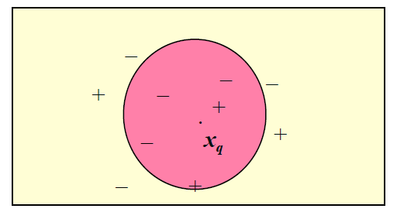
k-Nearest-Neighbor Classifiers
Find k-nearest-neighbors of a test tuple
Discrete-valued: most common values
Continuous-valued: average of k values
Give greater weight to closer neighbors
Indexing for nearest neighbor search
Ravi Starzl, PhD - Data Mining Fall 2023
Notes:
K-Nearest-Neighbor (K-NN) classifiers, a pivotal concept in machine learning, open a window into the realm of lazy learning. This approach inherently assumes that data points in close proximity exhibit similar properties, thereby weaving the operational tapestry of the k-NN algorithm. Lazy learning is characterized by its distinctive deferral of computations until function evaluation, which provides a flexible, yet precise, method for data categorization.
In the methodology of finding the k-nearest neighbors of a test tuple, the variable 'k' symbolizes a designated number of data points that are closest to the data sample being categorized. The term 'nearest' is defined through various distance measurement techniques, such as Euclidean, Manhattan, Minkowski, or Hamming distance. The selection of a particular distance measurement is heavily influenced by the unique characteristics of the dataset at hand, ensuring the precision and relevance of the categorization.
In scenarios where data is discrete-valued, the k-NN algorithm, upon identifying the k-nearest points, assigns the class most common amongst them to the data point in question, a process often referred to as majority voting. To illustrate, if a data point is to be classified into Class A or Class B, it will be assigned to the class most frequently occurring among its nearest neighbors, ensuring a categorization that reflects the predominant characteristics of its local data environment.
When dealing with continuous-valued data, the algorithm pivots towards calculating the mean of the values of the k-nearest neighbors for prediction. Consider a scenario such as estimating a house’s price based on various attributes. The k-NN algorithm identifies the k-nearest houses, calculates the average price, and assigns this as the predictive value for the target house, providing a nuanced, contextually relevant prediction.
In the nuanced strategy of giving greater weight to closer neighbors, the k-NN algorithm amplifies the influence of nearer data points, thus ensuring that the resulting classification is more heavily influenced by the most relevant data. This proximity-based weighting mitigates the impact of outliers or distant neighbors, refining the predictive accuracy of the algorithm.
The concept of indexing, fundamental to ensuring the efficiency of nearest-neighbor searches, involves employing algorithms to rapidly identify the dataset's data point that most closely resembles a given query point. This ensures swift identification of regions within the dataset likely to contain the nearest neighbors. Employing algorithmic solutions like the kd-tree or the BBF algorithm optimizes this process, although the ideal solution is often dictated by the specificities of the dataset and any computational limitations.

Slide 24
1
Bayesian belief
networks
2
Backpropagation
Advanced Classification
3
Support vector
machines
4
Lazy learning
5
Additional topics
regarding classification
6
Summary
Ravi Starzl, PhD - Data Mining Fall 2023

Slide 25
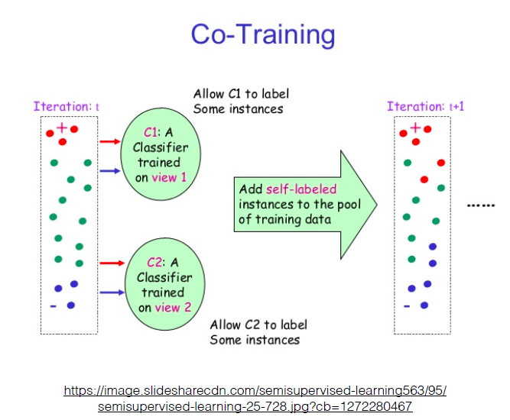
Rule Extraction
Multiclass classification
one-versus-all (OVA)
all-versus-all (AVA)
Semi-supervised training
self-training
cotraining
Ravi Starzl, PhD - Data Mining Fall 2023
Notes:
Multiclass Classification extends beyond binary classification by enabling categorization into more than two classes. This method is applicable to varied use cases, including document categorization, sentiment analysis, image recognition, and diagnostic processes in medical imagery, demonstrating its broad utility in practical scenarios.
The One-Versus-All (OVA) strategy facilitates multiclass classification by generating multiple binary classifiers, each contrasting one class against all remaining classes. During the classification process, each classifier evaluates a decision, with the highest confidence level determining the final class assignment. It’s imperative to acknowledge the assumption of mutual exclusivity between classes in this strategy.
Alternatively, the All-Versus-All (AVA) strategy forms binary classifiers for every possible pair of classes. Classifiers are specific to class pairs, and classification is determined through a voting mechanism, whereby each classifier’s vote is tallied and the class with the majority is selected. Despite its computational demand due to the increased number of classifiers, AVA offers robustness across varied class pair performances.
Semi-Supervised Training integrates elements of both supervised and unsupervised learning by employing labeled and unlabeled data. This method is particularly beneficial when acquiring labeled data is resource-intensive, yet unlabeled data is readily available, thereby optimizing resource utilization and maintaining prediction accuracy.
Self-Training begins with an initial model trained on a small labeled dataset. This model then assigns labels to unlabeled data, and if the predictions exhibit sufficient confidence, they are added to the training set. Although resource-efficient, it is crucial to note that high confidence in predictions does not ensure accuracy.
Co-Training separates a small labeled dataset into two independent and informatively sufficient views. Two classifiers are trained on each view and iteratively learn from the confident predictions from both views, fostering a mutually-enhancing learning process that utilizes different feature sets.

Slide 26
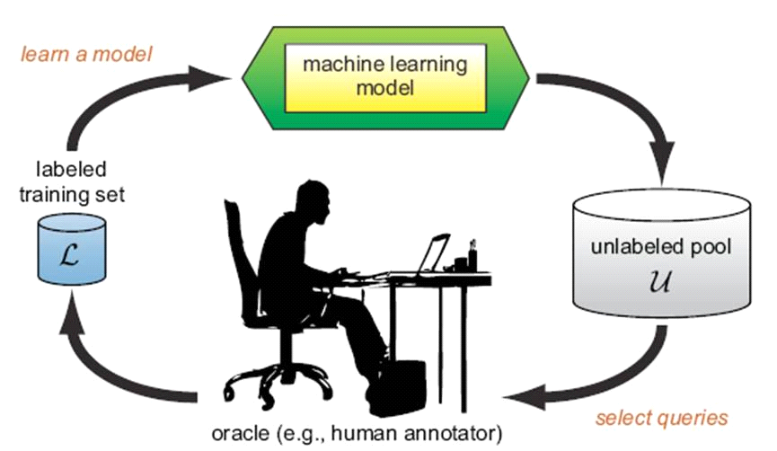
Active Learning
Achieve high accuracy using as few labeled instances as possible
Uncertainty sampling, vision space
Ravi Starzl, PhD - Data Mining Fall 2023
Notes:
Active Learning and Passive Learning in machine learning models differ primarily in their approach to data labeling and utilization. Passive learning employs a predefined set of labeled data points, processed sequentially by the model to discern patterns and insights. Alternatively, active learning selectively seeks and requests labels for instances deemed most informative, thereby operating in an iterative and self-directed manner.
Active learning demonstrates notable efficiency by utilizing fewer labeled instances to attain high prediction accuracy. This method, therefore, minimizes the requirement for expert input, which is typically resource-intensive. While the merits are clear, a deeper exploration into its advantages, supported by statistical data or particular use-case scenarios, would enhance the comprehensibility and applicability of these concepts.
An illustrative example of image categorization effectively demonstrates the operational dynamics of both active and passive learning. In this context, active learning optimizes the learning process by selectively querying the most informative data for labeling, thus demonstrating a pragmatic application of the theory.
Uncertainty Sampling is introduced as a query strategy integral to active learning. It operates on the principle that instances presenting the greatest model uncertainty, upon labeling, provide maximal informational gain. Potential challenges and necessary modifications to optimize uncertainty sampling are highlighted, displaying a comprehensive understanding of the topic.
Version Space is presented as a concept intrinsic to active learning, encapsulating all hypotheses consistent with the training data. A deeper exploration, supplemented with concrete examples or visual aids, would augment the understanding of version space and its applicability within the active learning paradigm.
Active learning is synthesized as a strategic and efficient approach to machine learning, particularly in scenarios where labeled data is scarce or expensive to obtain. By selecting instances for labeling and employing query strategies such as uncertainty sampling, active learning models optimize both data usage and learning efficacy. The practicality and functionality of active learning are further underscored by concepts like version space, which guide the model’s learning trajectory by iteratively refining the hypothesis space.

Slide 27
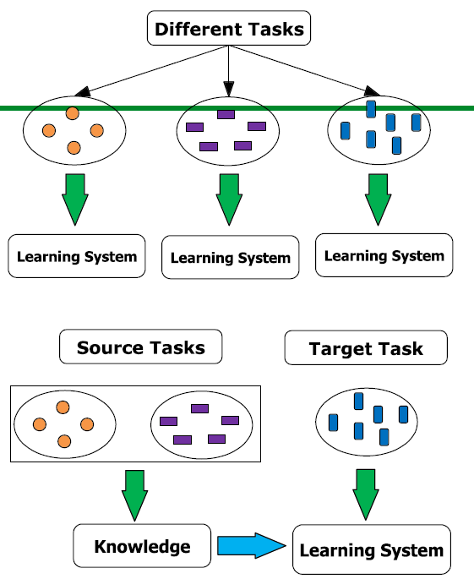
Transfer Learning
Utilize knowledge learned in source tasks for target task
E.g., sentiment classification: camera reviews => TV reviews
E.g., cars => trucks
Ravi Starzl, PhD - Data Mining Fall 2023
Notes:
Transfer Learning in Machine Learning: An In-depth Exploration
General Overview of Transfer Learning
Transfer learning, a pivotal concept in machine learning, seamlessly leverages knowledge acquired from one task to enhance performance in a related, subsequent task. It distinguishes itself by applying learned features beyond the initial scope, thereby elevating the versatility and learning capability of machine learning models.
Technical Understanding of Transfer Learning
Transfer learning capitalizes on a pre-trained model, typically an Artificial Neural Network (ANN) refined using a large, comprehensive dataset. This foundational model, rich in learned features, subsequently becomes a versatile base for multiple related tasks. An additional exploration detailing the specific adaptive mechanisms utilized to modify the pre-trained model for new tasks would amplify understanding and applicability.
Practical Applications of Transfer Learning
Consider a sentiment analysis model trained using numerous camera reviews. This model, adept at discerning positive and negative sentiments through keyword and phrase identification, can be repurposed to analyze sentiments within television reviews, owing to the similarity in language patterns across product types. Similarly, in image recognition tasks, a model proficient in recognizing cars can be adapted for recognizing trucks, leveraging shared features like wheels and windows.
Benefits Encompassed by Transfer Learning
Transfer learning not only conserves time and computational resources but also notably augments model performance, especially in scenarios constrained by limited data. By circumventing overfitting, which is prevalent when training afresh on smaller datasets, transfer learning assures the generation of robust, reliable models, proficient in feature generalization due to their extensive original training.
Origins and Influence of Transfer Learning
Though transfer learning draws inspiration from cognitive science and human knowledge transfer, a more in-depth discussion on its origins and its consequential influence on developing machine learning methodologies would provide a holistic perspective on its theoretical foundation and practical implications.

Slide 28
Support Vector Machines, SVM
Lazy learning
Naïve Bayes classifier / Bayesian Networks
Deep Neural Networks
Multi-class Classification, Semi-supervised Training, Active Learning, and Transfer Learning
Summary
Ravi Starzl, PhD - Data Mining Fall 2023

Slide 29
Thank you
A special thank you to Qin Lv for her slides, on which this lecture is based
Ravi Starzl, PhD - Data Mining Fall 2023

